Slide 1
Building blocks schedule - Digital tool UI feedback & Laptop logic
20260331

Slide 2
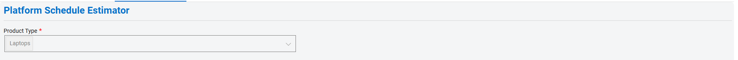
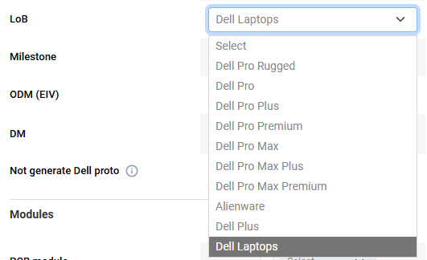
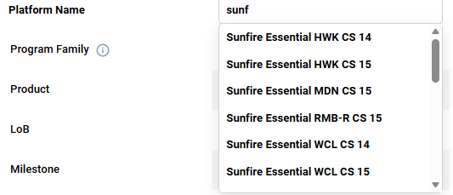
Building blocks schedule - Digital tool UI feedback
Add Lob and Program name , user can input manually or can select the name which extract from Jira
For new gen not in Jira yet – manual input
For already in Jira program – extract list from Jira and user to select
Combine with page-3 (Save) function for traceability , and more efficiency if already defined program/schedule
Lob
Program Name
e.g Dell / Dell Pro / XPS
e.g. Binary INT NVL 14
Notes:
Dev Schedule Building Blocks
Executive Summary
Single, End‑to‑End Critical Path Establish clear visibility and ownership by identifying and quantifying each function’s contribution to the program critical path.
Standardized 9‑Scenario Baseline Apply one consistent schedule framework across all Consumer and Commercial laptops to enable portfolio‑level alignment and comparability.
Predictable, Faster Execution Increase schedule confidence, improve decision speed, and reduce late‑stage risk from DDS through RFD.
- One aligned critical path across all functions
- One baseline applied consistently across the portfolio
- Higher predictability, faster decisions, lower execution risk

Slide 3
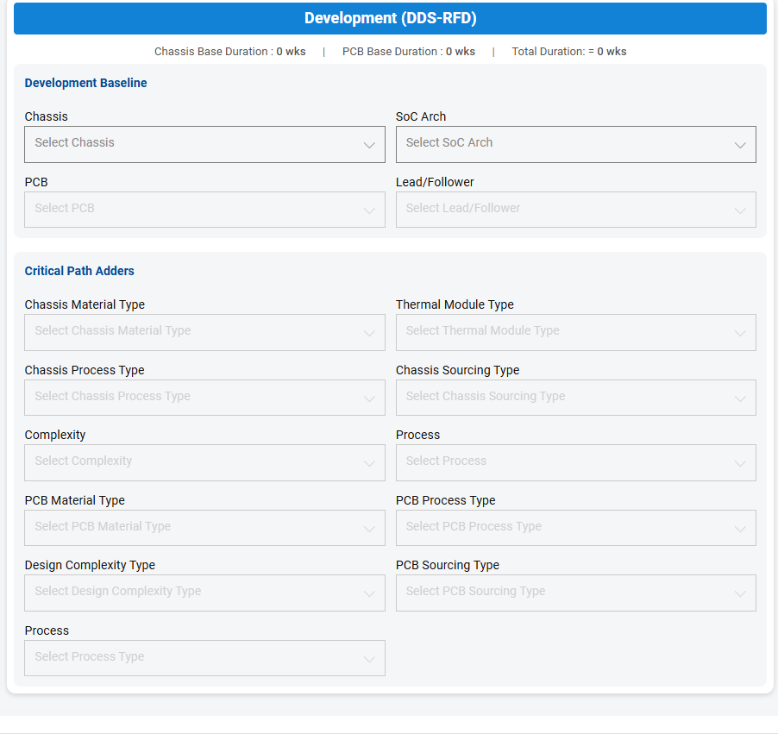
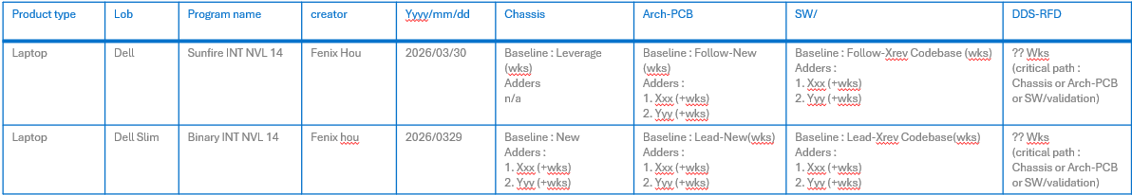
Building blocks schedule - Digital tool UI feedback
Save button on the bottom to save selected condition and schedule
Current only creator can check what he/she created
Long-term idea able to have cross LoB/program name/creator comparison
Save
Save Log
Save Log (example):
Product type | Lob | Program name | creator | Yyyy/mm/dd | Chassis | Arch-PCB | SW/ | DDS-RFD
Laptop | Dell | Sunfire INT NVL 14 | Fenix Hou | 2026/03/30 | Baseline : Leverage (wks) Adders n/a | Baseline : Follow-New (wks) Adders : 1. Xxx (+wks) 2. Yyy (+wks) | Baseline : Follow-Xrev Codebase (wks) Adders : 1. Xxx (+wks) 2. Yyy (+wks) | ?? Wks (critical path : Chassis or Arch-PCB or SW/validation)
Laptop | Dell Slim | Binary INT NVL 14 | Fenix hou | 2026/0329 | Baseline : New Adders : 1. Xxx (+wks) 2. Yyy (+wks) | Baseline : Lead-New(wks) Adders : 1. Xxx (+wks) 2. Yyy (+wks) | Baseline : Lead-Xrev Codebase(wks) Adders : 1. Xxx (+wks) 2. Yyy (+wks) | ?? Wks (critical path : Chassis or Arch-PCB or SW/validation)
Notes:
Dev Schedule Building Blocks
Executive Summary
Single, End‑to‑End Critical Path Establish clear visibility and ownership by identifying and quantifying each function’s contribution to the program critical path.
Standardized 9‑Scenario Baseline Apply one consistent schedule framework across all Consumer and Commercial laptops to enable portfolio‑level alignment and comparability.
Predictable, Faster Execution Increase schedule confidence, improve decision speed, and reduce late‑stage risk from DDS through RFD.
- One aligned critical path across all functions
- One baseline applied consistently across the portfolio
- Higher predictability, faster decisions, lower execution risk

Slide 4
Building blocks schedule - Digital tool UI feedback
Development Schedule (DDS – RFD) : xx weeks (max of Chassis, Arch-PCB, or SW)
Chassis (xx w) - Baseline (yy w) ; Adders (zz w) | Arch-PCB (xx w) - Baseline (yy w) ; Adders (zz w) | SW (xx w) - Baseline (yy w) ; Adders (zz w)
Development Baseline
Critical Path Adders
ME/Chassis
Chassis Material
Chassis Special Process
Tooling Complexity
Thermal Design
Tooling Sourcing
Process
(default : Texture plastic)
(default : N/A)
(default : N/A)
(default : heat pipe + plate)
(default : Tooling vendor colocation)
(default : No ER)
EE/Arch – PCB
PCB Layer
PCB Type
PCB special process
Design Complexity – CPU/GPU
Design Complexity – TBT
PCB Sourcing
Process
(default : ≤12L)
(default : Std Type-3)
(default : N/A)
(default : x86 UMA)
(default : TBT ≤ 2 ports
(default : PCB vendor colocation)
(default : No ER)
SW
EE/ME Adders
Design Complexity – CPU
Design Complexity – GPU
Not for user input , default : N/A; or show +xx wks
(default : x86 CPU)
(default : UMA)
Notes:
Dev Schedule Building Blocks
Executive Summary
Single, End‑to‑End Critical Path Establish clear visibility and ownership by identifying and quantifying each function’s contribution to the program critical path.
Standardized 9‑Scenario Baseline Apply one consistent schedule framework across all Consumer and Commercial laptops to enable portfolio‑level alignment and comparability.
Predictable, Faster Execution Increase schedule confidence, improve decision speed, and reduce late‑stage risk from DDS through RFD.
- One aligned critical path across all functions
- One baseline applied consistently across the portfolio
- Higher predictability, faster decisions, lower execution risk

Slide 5
Building blocks schedule - Laptop logic (Chassis)
 | Catagotry | Attribute | Select factors | Duration
 | Baseline | Chassis | New | 20
 | Baseline | Chassis | Leverage | 0
 | Catagotry | Attribute | Select factors | Adder | apply if chassis baseline =New
1 | Type 1 Adders (Max rule) | Chassis Material | Texture Plastic | 0 | single select default - Texture Plastic (Default adder =0)
 | Type 1 Adders (Max rule) | Chassis Material | Paint Plastic | 1.5
 | Type 1 Adders (Max rule) | Chassis Material | AL Stamping | 4
 | Type 1 Adders (Max rule) | Chassis Material | Die-casting (Inner Main) | 10
 | Type 1 Adders (Max rule) | Chassis Material | Die-cating (Cover) | 12
 | Type 1 Adders (Max rule) | Chassis Material | CNC | 16.5
2 | Type 1 Adders (Max rule) | Thermal Design | Heat-pipe & plate | 0 | Single select, default - Heat-pipe & plate (Default adder =0)
 | Type 1 Adders (Max rule) | Thermal Design | Vaper Chamber (VC) | 15
3 | Type 2 Adders (stack rule) | Chassis special | Press-in Hinge | 1.5 | Multi select, stack up default - N/A (Default adder =0)
 | Type 2 Adders (stack rule) | Chassis special | AL/MG+Insert mold | 1.5 |  | Insert mold only apply if Chassis material = AL Stamping or both Die-casting
 | Type 2 Adders (stack rule) | Chassis special | hinge-up sub-assy/bounding | 1
4 | Type 2 Adders (stack rule) | Chassis Sourcing | vendor colocation | 0 | Single select, default - vendor colocation (Default adder =0)
 | Type 2 Adders (stack rule) | Chassis Sourcing | vendor non-colocation | 1
5 | Type 2 Adders (stack rule) | Process | ER | 2 | Single select (No = 0 / Yes =2) default - No ER (Default adder =0)
6 | Type 2 Adders (stack rule) | Tool Complexity | Complexity adder | 3.5 | Multi-select, default - N/A (Default adder =0) 0 if N/A or hinge-up * base <3 3.5 if hinge-up * base ≥3 | Complexity adder only apply if Chassis material = Texture plastic, Paint plastic or AL Stamping
 |  |  |  |  | WWAN w/diff. A/B cover | (hinge-up)
 |  |  |  |  | camera w/diff. A/B cover | (hinge-up)
 |  |  | Complexity Adder |  | panel w/diff. A/B cover | (hinge-up)
 |  |  | Select options |  | WWAN w/diff. C/D cover | (base)
 |  |  |  |  | KB outline w/diff. C/D cover | (base)
 |  |  |  |  | Smartcard w/diff. C/D cover | (base)
Chassis Adders = MAX (2+4+5, 1+3+4+5+6)
Notes:
Dev Schedule Building Blocks
Executive Summary
Single, End‑to‑End Critical Path Establish clear visibility and ownership by identifying and quantifying each function’s contribution to the program critical path.
Standardized 9‑Scenario Baseline Apply one consistent schedule framework across all Consumer and Commercial laptops to enable portfolio‑level alignment and comparability.
Predictable, Faster Execution Increase schedule confidence, improve decision speed, and reduce late‑stage risk from DDS through RFD.
- One aligned critical path across all functions
- One baseline applied consistently across the portfolio
- Higher predictability, faster decisions, lower execution risk

Slide 6
Building blocks schedule - Laptop logic (Arch-PCB)
Catagotrydef | Attribute | Select factors | Duration
Baseline | Arch-PCB | Lead-New | 23.5
Baseline | Arch-PCB | Follow-New | 17
Baseline | Arch-PCB | Follow-Leverage | 0
Catagotry | Attribute |  | Lead-New Adder | Follow-New Adder
 | PCB Layer | Refer to page-7 “PCB Layer” “4L” to “16L” | x4 | x3 | Single select, detail refer to “PCB LT”, default ≤12L | Default adder =0
 | PCB Type | Refer to page.7 “PCB type” “STD Type-3” to “HDI anylayer” |  |  | Single select, detal refer to “PCB LT”. default = Std Type-3
 | PCB Process | special process - selective ENIG | 2 | 1.5 | Multi selection, stack-up rule default = N/A (default adder=0)
 | PCB Process | special process - ENIG | 1.34 | 1
 | PCB Process | special process - Black ink | 1.34 | 1
 | PCB Process | special process - back drill | 1.34 | 1
 | PCB Process | special process - VIPPO | 2 | 1.5
 | PCB Sourcing | vendor colocation | 0 | 0 | Single select, default - vendor colocation
 | PCB Sourcing | vendor non-colocation | 2 | 1.5
 | Process | ER | 2 | 2 | Single select, (No =0 / Yes =2) default - No ER (Default adder =0)
 | EE design Complexity - CPU/GPU | STD PCB - x86 UMA | 0 | 0 | Apply if PCB type = Std Type-3 single select, default = STD PCB - x86 UMA (Default adder =0)
 | EE design Complexity - CPU/GPU | STD PCB - dGPU STD PCB | 0 | 1
 | EE design Complexity - CPU/GPU | STD PCB - QC/NV UMA | 1 | 2
 | EE design Complexity - CPU/GPU | STD PCB - OC/NV + dGPU | 2 | 3
 | EE design Complexity - CPU/GPU | HDI PCB - x86 UMA | 0.5 | 1.5 | Apply if PCB type = HDI* single select, default = HDI PCB - x86 UMA
 | EE design Complexity - CPU/GPU | HDI PCB - dGPU | 1 | 2
 | EE design Complexity - CPU/GPU | HDI PCB - QC/NV UMA | 1 | 2
 | EE design Complexity - CPU/GPU | HDI PCB - OC/NV + dGPU | 2 | 3
 | EE design Complexity - TBT | TBT port ≤2 | 0 | 0 | Single select Default = TBT port ≤2 Default adder =0)
 | EE design Complexity - TBT | TBT port x3 | 0.5 | 0.5
 | EE design Complexity - TBT | TBT port x4 | 1 | 1
Notes:
Dev Schedule Building Blocks
Executive Summary
Single, End‑to‑End Critical Path Establish clear visibility and ownership by identifying and quantifying each function’s contribution to the program critical path.
Standardized 9‑Scenario Baseline Apply one consistent schedule framework across all Consumer and Commercial laptops to enable portfolio‑level alignment and comparability.
Predictable, Faster Execution Increase schedule confidence, improve decision speed, and reduce late‑stage risk from DDS through RFD.
- One aligned critical path across all functions
- One baseline applied consistently across the portfolio
- Higher predictability, faster decisions, lower execution risk

Slide 7
Building blocks schedule - Laptop logic (PCB LT)
Lead-New = Adder x4
Follow-New = Adder x3
 | *adders | PCB Type
 | PCB LT | Std Type-3 | HDI 1-x-1 | HDI 2-x-2 | HDI 2-x-2 + | HDI 3-x-3 | HDI 3-x-3+ | HDI 4-x-4 | HDI 4-x-4+ | HDI 5-x-5 | HDI 5-x-5+ | HDI AnyLayer
PCB Layer | 4L | 0 | n/a | n/a | n/a | n/a | n/a | n/a | n/a | n/a | n/a | n/a
 | 6L | 0 | 0.5 | 0.5 | n/a | n/a | n/a | n/a | n/a | n/a | n/a | 1.5
 | 8L | 0 | 0.5 | 0.5 | 0.5 | 1 | n/a | n/a | n/a | n/a | n/a | 1.5
 | 10L | 0 | 0.5 | 0.5 | 1 | 1 | 1.5 | 2 | n/a | n/a | n/a | 2
 | 12L | 0 | 0.5 | 1 | 1 | 1.5 | 1.5 | 2 | 2 | 2 | n/a | 2
 | 14L | 0.5 | 1 | 1 | 1 | 1.5 | 1.5 | 2.5 | 2.5 | 2.5 | 2.5 | 2.5
 | 16L | n/a | n/a | n/a | n/a | n/a | n/a | n/a | n/a | 2.5 | 2.5 | n/a
Notes:
Dev Schedule Building Blocks
Executive Summary
Single, End‑to‑End Critical Path Establish clear visibility and ownership by identifying and quantifying each function’s contribution to the program critical path.
Standardized 9‑Scenario Baseline Apply one consistent schedule framework across all Consumer and Commercial laptops to enable portfolio‑level alignment and comparability.
Predictable, Faster Execution Increase schedule confidence, improve decision speed, and reduce late‑stage risk from DDS through RFD.
- One aligned critical path across all functions
- One baseline applied consistently across the portfolio
- Higher predictability, faster decisions, lower execution risk

Slide 8
Building blocks schedule - Laptop logic (SW baseline)
1. define SW baseline attribute
Logic |  | FC to BCO | BCO to A-rev | FV | #1 Total duration
Lead, X-rev Codebase | only selectable while Arch-PCB baseline = Lead-New | 4 | 6 | 2 | 12
Follow, X-rev Codebase | selectable if Arch-PCB = follow-new or leverage | 4 | 4 | 1.5 | 9.5
Follow, A-rev Codebase | selectable if Arch-PCB = follow-new or leverage | 3 | 4 | 1.5 | 8.5
2. define baseline DDS to FC (feature compelet)
Logic |  |  |  |  |  |  |  |  | DDS to FC
 | A = default 1st sample to FC |  | Arch-PCB | B = x00 PWA ready | C = x01 PWA ready | Chassis | D = T1 material ready | E=1st assy. unit ready | F=DDS to FC
Lead, X-rev Codebase | 6 |  | Lead-New | SUM(E32:H32) | SUM(E32:K32) | New | SUM(E4:J4) | MAX(C+0.5 , D+0.5) | MAX(A+B , E)
Lead, X-rev Codebase | 6 |  | Lead-New | SUM(E32:H32) | SUM(E32:K32) | Leverage | 0 | MAX(C+0.5 , D+0.5) | MAX(A+B , E)
Follow, X-rev Codebase | 3 |  | Follow-New | SUM(E33:H33) | SUM(E33:K33) | New | SUM(E4:J4) | MAX(B+0.5 , D+0.5) | MAX(A+B , E)
Follow, X-rev Codebase | 3 |  | Follow-Leverage | 3 | 0 | Leverage | 0 | B+0.5 | MAX(A+B , E)
Follow, A-rev Codebase | 1 |  | Follow-New | SUM(E33:H33) | SUM(E33:K33) | New | SUM(E4:J4) | MAX(B+0.5 , D+0.5) | MAX(A+B , E)
Follow, A-rev Codebase | 1 |  | Follow-Leverage | 3 | 0 | Leverage | 0 | B+0.5 | MAX(A+B , E)
3. Baseline SW duration
DDS to FC | + | FC to BCO | + | BCO to A-rev | + | FV | = | baseline SW duration = #1 + #2
based on #2 calculation |  | 4 |  | 6 |  | 2
 |  | 4 |  | 4 |  | 1.5
 |  | 3 |  | 4 |  | 1.5
Notes:
Dev Schedule Building Blocks
Executive Summary
Single, End‑to‑End Critical Path Establish clear visibility and ownership by identifying and quantifying each function’s contribution to the program critical path.
Standardized 9‑Scenario Baseline Apply one consistent schedule framework across all Consumer and Commercial laptops to enable portfolio‑level alignment and comparability.
Predictable, Faster Execution Increase schedule confidence, improve decision speed, and reduce late‑stage risk from DDS through RFD.
- One aligned critical path across all functions
- One baseline applied consistently across the portfolio
- Higher predictability, faster decisions, lower execution risk

Slide 9
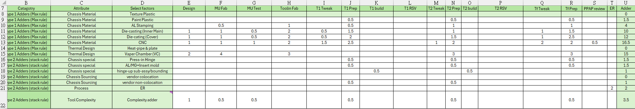
Building blocks schedule - Laptop logic (SW Adder-1 : EE/ME for “DDS to FC”)
1. DDS to FC Adders
Logic |  |  |  |  |  |  |  |  | DDS to FC Adders
EE/ME impact adders |  |  |  | B adders | C adders |  | D adders
if Arch-PCB = Lead-New |  |  |  | based on selected adder to sum E37~H57 | based on selected adder to sum E37~K57
if Arch-PCB = Follow-New |  |  |  | based on selected adder to sum E60-H80 | based on selected adder to sum E60-K80
if chassis = New |  |  |  |  |  |  | based on selected adder to sum E8~J22
 | A (same as baseline) |  |  | B baseline + B adders | C baseline + C adders |  | D baseline + D adders | E (same logic as above | Fnew = DDS to FC with Adder
 |  |  |  |  |  |  |  |  | Fnew - F baseline = EE/ME impacted DDS to FC adder
Building blocks schedule - Laptop logic (SW EE/ME Adders - ME/Chassis data)
Notes:
Dev Schedule Building Blocks
Executive Summary
Single, End‑to‑End Critical Path Establish clear visibility and ownership by identifying and quantifying each function’s contribution to the program critical path.
Standardized 9‑Scenario Baseline Apply one consistent schedule framework across all Consumer and Commercial laptops to enable portfolio‑level alignment and comparability.
Predictable, Faster Execution Increase schedule confidence, improve decision speed, and reduce late‑stage risk from DDS through RFD.
- One aligned critical path across all functions
- One baseline applied consistently across the portfolio
- Higher predictability, faster decisions, lower execution risk

Slide 10
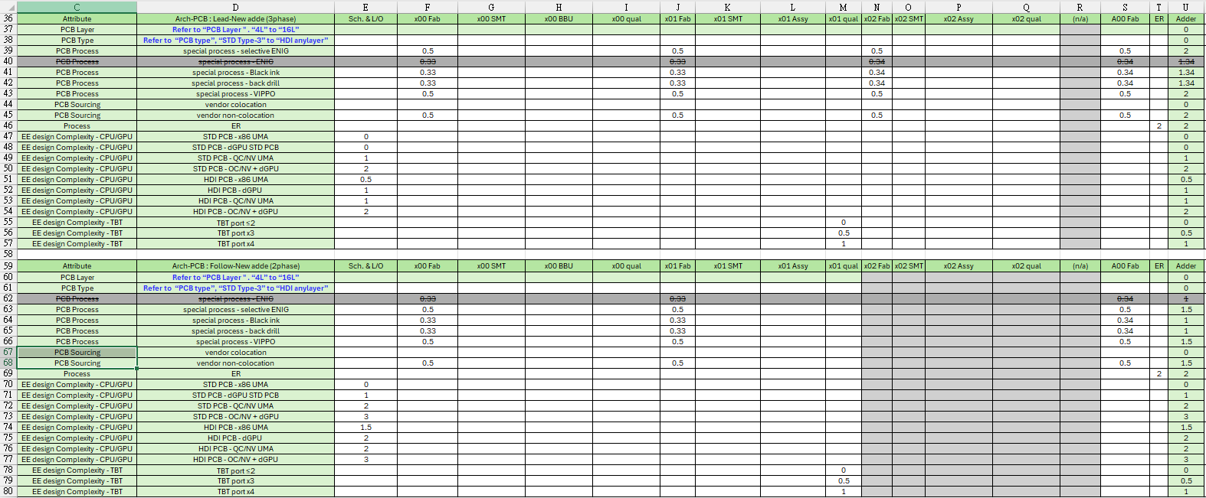
Building blocks schedule - Laptop logic (SW EE/ME Adders - Arch-PCB data)
Laptop logic (PCB LT) x1
Laptop logic (PCB LT) x1
Laptop logic (PCB LT) x1
Laptop logic (PCB LT) x1
Notes:
Dev Schedule Building Blocks
Executive Summary
Single, End‑to‑End Critical Path Establish clear visibility and ownership by identifying and quantifying each function’s contribution to the program critical path.
Standardized 9‑Scenario Baseline Apply one consistent schedule framework across all Consumer and Commercial laptops to enable portfolio‑level alignment and comparability.
Predictable, Faster Execution Increase schedule confidence, improve decision speed, and reduce late‑stage risk from DDS through RFD.
- One aligned critical path across all functions
- One baseline applied consistently across the portfolio
- Higher predictability, faster decisions, lower execution risk

Slide 11
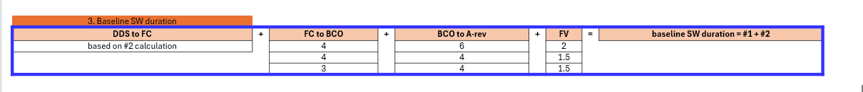
Building blocks schedule - Laptop logic (SW Adders-3)
2. BCO to A-rev Adders | Selection | BCO to A-rev Adders | Total BCO to Arev
Design complexity - CPU | x86 UMA | 0 (default) | Max (4, 3.5, 0) + baseline BCO to Arev
 | QC/NV UMA | 3.5
Design complexity GPU | UMA | 0 (default)
 | w/dGPU & CPU QS@DVT2 | 4
Notes:
Dev Schedule Building Blocks
Executive Summary
Single, End‑to‑End Critical Path Establish clear visibility and ownership by identifying and quantifying each function’s contribution to the program critical path.
Standardized 9‑Scenario Baseline Apply one consistent schedule framework across all Consumer and Commercial laptops to enable portfolio‑level alignment and comparability.
Predictable, Faster Execution Increase schedule confidence, improve decision speed, and reduce late‑stage risk from DDS through RFD.
- One aligned critical path across all functions
- One baseline applied consistently across the portfolio
- Higher predictability, faster decisions, lower execution risk

Slide 12

Building blocks schedule - Laptop logic (Excel calculator for reference)
Goal : input RTS date can auto calculate all of the key milestone with considering holiday
Notes:
Dev Schedule Building Blocks
Executive Summary
Single, End‑to‑End Critical Path Establish clear visibility and ownership by identifying and quantifying each function’s contribution to the program critical path.
Standardized 9‑Scenario Baseline Apply one consistent schedule framework across all Consumer and Commercial laptops to enable portfolio‑level alignment and comparability.
Predictable, Faster Execution Increase schedule confidence, improve decision speed, and reduce late‑stage risk from DDS through RFD.
- One aligned critical path across all functions
- One baseline applied consistently across the portfolio
- Higher predictability, faster decisions, lower execution risk

Slide 13
Backup

